Slide 1
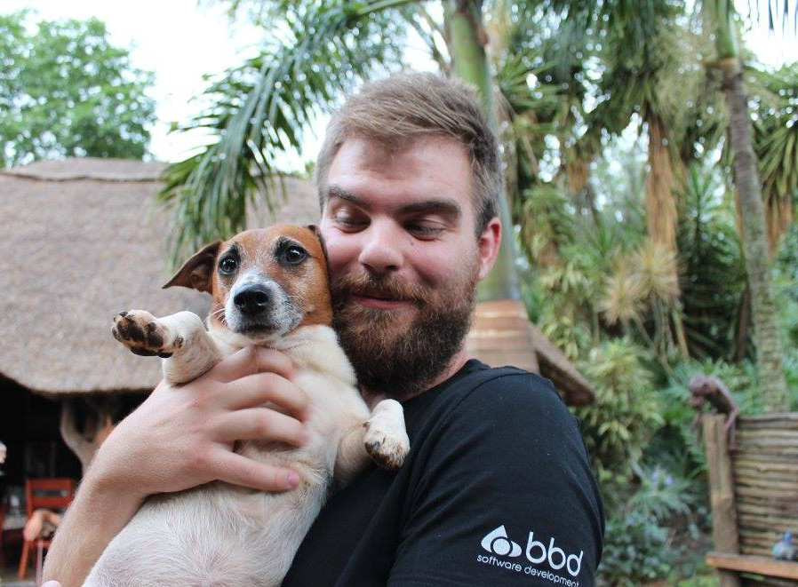

Spring Cloud Stream
Thomas Bezuidenhout
BBD @ Momentum
@victorness124

Slide 2
What is Spring Cloud Stream?
Messaging
Spring Integration
Convention over Configuration
Facilitate Microservices
Notes:
- Channel is some abstract concept
- Can configure the lower level objects at will, just don’t need to from the get go
- Spring integration based on Enterprise Integration Patterns book (haven’t read it)
- Facilitates seamless, async communications between microservices via some intermediary broker

Slide 3
What is RabbitMQ?
Durable, distributed message broker
Highly available via clustering and federation
Multiple messaging protocols
Dynamic routing
Monitoring
Plugin architecture
Notes:
- Pretty much self-explanatory

Slide 4
Some Code
Pub/Sub between Spring Applications
Additional non JVM components
Direct messaging with subscription groups
Durability
Notes:
- @EnableBinding Annotation to allow connectivity to a defined broker
- Start with the producer. How is the code wired up? What does the @Input annotation do? How do we define channels and destination?
- Do the consumer next. Describe the relationship between the destinations between consumer and producer. Describe how the channel names themselves are abstract, logical concepts
- Introduce the NodeJS consumer for the pub/sub stuff. Describe how it’s bound via the routing key, not by any queue name
- Introduce the idea of subscription groups, and how these groups identify consumers of messages
- Introduce the durableSubsription configuration option, and describe how it ensures durable messages, even without consumers

Slide 5
MongoDB Integration (quickly)
Spring Data Abstraction
Convention over Configuration
POJO’s as Models
Spring Data integration (repositories), Spring Data REST integration

Slide 6
Final Notes
Spring Integration > Spring Cloud Stream
Spring Cloud Stream Binders
Spring Data (JPA for who?)
Spring Cloud Projects
Notes:
- Describe how spring integration is a superset of Spring Cloud Stream, and that one can drop down into the core Integration components when needs be (as you can see in the code of the consumer)
- Different binders exist, such as ActiveMQ, IBM MQ, HornetQ, plain old JMS, etc.
- Spring Data for MongoDB simplifies interactions with Mongo, and makes you cool and hipster-like for not using JPA anymore
- SCS and Spring Integration are only some of the available projects under the Spring Cloud umbrella. Includes Spring Cloud Dataflow, Spring Cloud AWS, Zipkin, Hystrix, etc.

Slide 7
Questions?
All code & slides available on GitHub
https://github.com/CrAzE124/bbd_demo

